Slide 1

Hardware connectivity
Explained
Team:
Kimanie Taylor
Javouy Bourne

Slide 2
Topics
IP convergence
UWB
Cellular 3G/4G&5G

Slide 3
IP Convergence
IP Convergence implies the carriage of different types of traffic such a voice, data, and images over a single network.
The integrated network is based on the Internet Protocol (IP).
IP Convergence has improved dramatically since the technology was introduced in the mid-1990s.
Through IP technology, signals like voice and video can be easily converted into digital data, compressed into IP packets and transported over a single, packet-switched IP network, eliminating the need for circuit switched phone networks and delivering a number of personal and business advantages
Data travels across the Internet courtesy of several sets of rules called protocols.
Protocols make up the internet protocol, or IP. The standardized set of rules is what allows o computers to communicate across networks.

Slide 4
Benefits of IP Convergence
Excellent support for multimedia applications. Improved connectivity means that devices can be assigned specific tasks.
A converged IP Network is a single platform on which interoperable devices can be run in innovative ways. Since IP is an open standard, it is vendor network efficiency in terms of time and cost.
A converged IP network is easier to manage because of the uniform setup in which the system resources operate.
IP Networks have proven to be remarkably scalable and this has been one of the prime reasons that even large enterprises have gone ahead with implementing IP. Applications that run on IP networks are available all over the world; in fact most new business applications include inbuilt IP support.
An IP Converged IP network offers a business tremendous cost savings in terms of hardware and space utilization.

Slide 5
Benefits of IP Convergence(Cont.)
An IP Converged IP network is capable of making use of the developments in class of service differentiation and Qos-based routing. This leads to better utilization of resources and also allows for capacity redundancy to take care of an increase in the number of users.

Slide 6
Ultra-wideband (UWB)
Ultra-wideband (also known as UWB, ultra-wide band and ultra-band) is a radio technology that can use a very low energy level for short-range, high-bandwidth communication over a large portion of the radio spectrum.
UWB transmit in a manner that does not interface with conventional narrowband and carrier waves transmission in the same frequency band.
Ultra-wideband was formerly known as pulse radio, but the FCC and the international Telecommunication Union Radio communication Sector (ITU-R) currently define UWB as an antenna transmission for which emitted signal bandwidth exceeds the lesser of 500 MHz or 20% of the arithmetic center frequency.

Slide 7
Benefits of UWB
Coexistence with current narrowband and wideband radio services result in less expensive fees.
High bandwidth can support real-time high definition video streaming.
Low probability of intercept and detection because of their low average transmission power, UWB communications systems have an inherit immunity to detection and intercept.
The UWB spectrum covers a vast spectrum covers a vast range of frequencies from near DC to several gigahertz and offers high processing gain for UWB signals, this allow UWB to resist jamming.
Enables ultra-low power, smaller form factor, and better mean time between failures, all at reduced cost.
Delivers higher signal strength in advance conditions.
Reliable in hostile environments.

Slide 8
pervasive 802.11n
Streaming around the home will involve TVs and DVRs with wireless capability and 100+ Mbps aggregate of videos from DVR can be displayed wirelessly on TVs in different rooms. Rapid sync-and-go will allow users to quickly sync movies or pictures between mobile devices, such as a phone and a laptop. With a 1 Gbps radio link, transferring a 1 GB video file will take less than a minute.
802.11ac operates in the 5 GHz band. Its scope includes:
Single link throughput supporting at least 500 Mbps,
Multi-station throughput of at least 1 Gbps,
Exclusion of 2.4 GHz band,
Backward compatibility and co-existence with legacy 802.11 devices in the 5 GHz band.

Slide 9
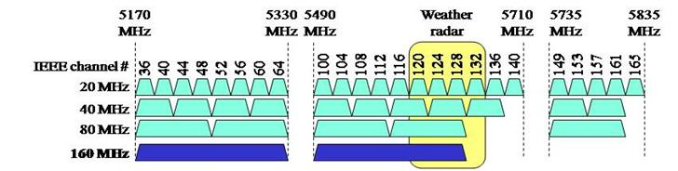
pervasive 802.11n(Cont.)
802.11n supports features such as MIMO, 40 MHz and packet aggregation to significantly increase data rates of 802.11a/b/g. As an evolution of 802.11n, 802.11ac adds 80 MHz, 160 MHz and non-contiguous 160 MHz (80 + 80 MHz) channel bandwidth. 802.11ac enhances throughput with its multi-user capability in the form of downlink multi-user MIMO (DL MU-MIMO).
802.11ac increases the modulation constellation size from 64 QAM to 25 QAM. The number of spatial streams is increased to 8 to support DL MU-MIMO. The packet aggregation size limits are increased to support higher data rates. 802.11ac defines non-overlapping channels to avoid in-band interference.

Slide 10

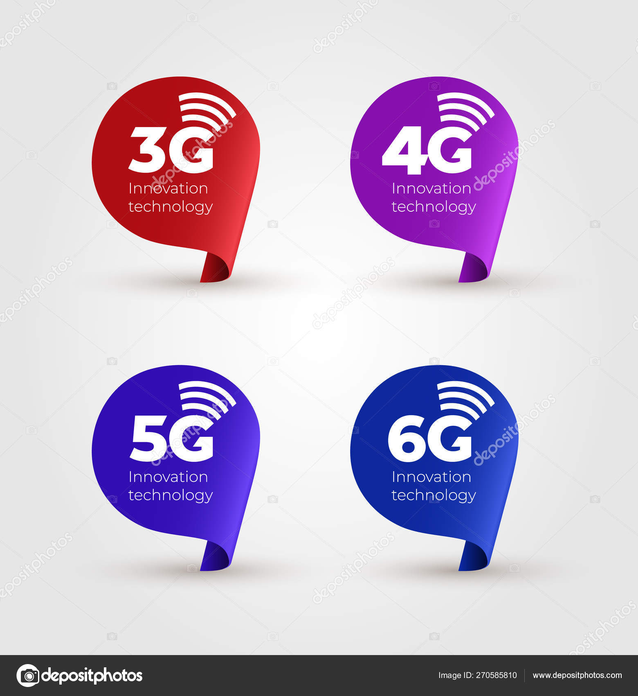
Cellular 3G and 4G, even 5G!
A cellular network or mobile network is a communication network where the last link is wireless. The network is distributed over land areas called "cells", each served by at least one fixed-location transceiver, but more normally, three cell sites or base transceiver stations.

Slide 11
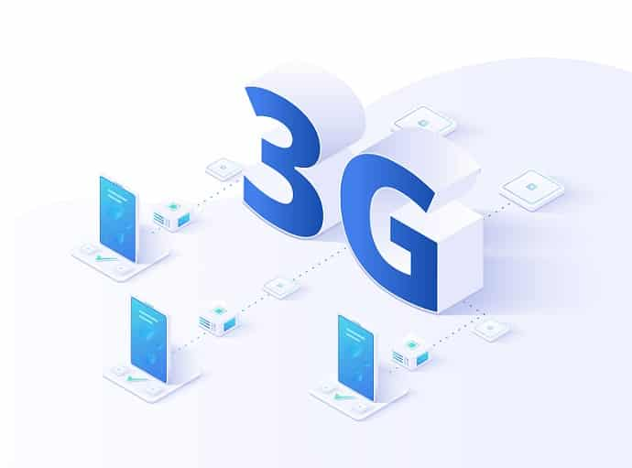
3G Third Generation
3G has to do with mobile phone and data communications. 3G is defined as the 3rd generation of mobile phone and data communication standards, featuring higher bandwidth for web-based applications and video. It was first available in May 2001 as a pre-release (test) of W-CDMA technology. The first commercial launch of 3G was also by NTT DoCoMo in Japan on 1 October 2001, although it was initially somewhat limited in scope; broader availability of the system was delayed by apparent concerns over its reliability.

Slide 12
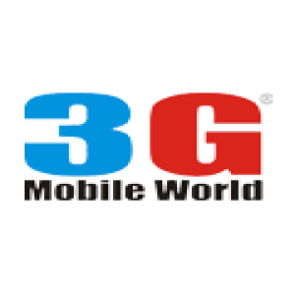
3G Speed
In theory, 3G services allow a user to have an internet speed of at least 7.2 Mbps (Megabits per second). This gives users the ability to download documents, images, and videos within a few minutes. In reality, the speed of 3G services can only reach up to a maximum of 3 Mbps.

Slide 13

4G Fourth Gen
4G is the fourth generation of broadband cellular network technology, succeeding 3G. A 4G system must provide capabilities defined by ITU in IMT Advanced. The world's first publicly available LTE service was opened in the two Scandinavian capitals, Stockholm (Ericsson and Nokia Siemens Networks systems) and Also (a Huawei system) on December 14, 2009, and branded 4G. The user terminals were manufactured by Samsung. 4G is often up to 10x faster than 3G in real-world use – with speeds commonly between 20Mbps and 50Mbps (which is really fast). 3G and 4G are both networks that connect your phone to the internet. The “G” in each stand for generation.
So, where 3G means 'third generation', 4G stands for 'fourth generation'. As it is with most techy things, the larger number indicates the newer, better version of a particular technology.

Slide 14
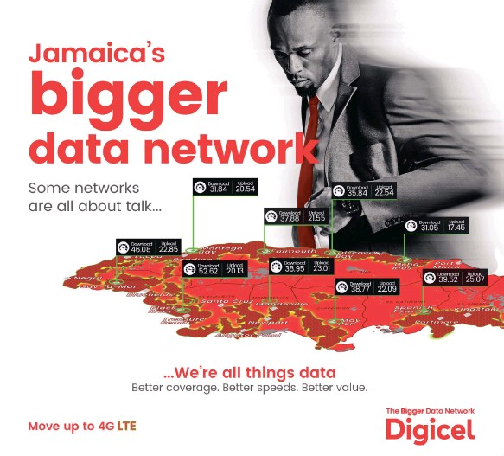
4G Speed
4G offers maximum real-world download speeds up to around 100Mbps, making it over 20 times faster than 3G. 4G LTE wireless broadband is 10 times faster than 3G — able to handle download speeds between 5 and 12 Mbps (Megabits per second) and upload speeds between 2 and 5 Mbps, with peak download speeds approaching 50 Mbps. Cable speeds vary, but 4 to 12 Mbps are common.

Slide 15

Now! 5G Fifth Generation
While 4G tops out at a theoretical 100 megabits per second (Mbps), 5G tops out at 10 gigabits per second (Gbps). That means 5G is a hundred times faster than the current 4G technology—at its theoretical maximum speed, anyway. 5G will elevate the mobile network to not only interconnect people, but also interconnect and control machines, objects, and devices. It will deliver new levels of performance and efficiency that will empower new user experiences and connect new industries. 5G will deliver multi-Gbps peak rates, ultra-low latency, massive capacity, and more uniform user experience. 5G is a new kind of network: a platform for innovations that will not only enhances today’s mobile broadband services, but will also expand mobile networks to support a vast diversity of devices and services and connect new industries with improved performance, efficiency, and cost. 5G will redefine a broad range of industries with connected services from retail to education, transportation to entertainment, and everything in between. We see 5G as technology as transformative as the automobile and electricity.

Slide 16
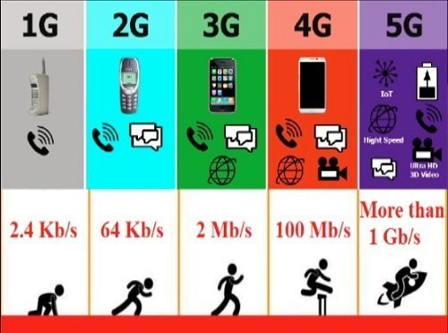
New World, A new dawn!
When 5G is fully implemented, it will be set to supercede the old generation of network connectivity by powering groundbreaking technology including AI, cloud computing, smart cities, and autonomous transport. The new network will help spearhead the fourth industrial revolution. Construction of 5G infrastructure is already well underway for many internet and telecommunication providers.

Slide 17
